Slide 1
FILE SYSTEM
Team members : Adarsh. K .A Abhiram Kudala
Dhwani Patel Mariah Fernandes
Neeraj Narkar Sneha Nair
Swapnil Kadam
Date: 10/01/2014

Slide 2
INTRODUCTION
File System provides a layer of abstraction .
Controls information storage and retrieval.
It provides facilities for storing, accessing, organizing and managing the
stored data.
File System contains the following Modules:
Initialization
File system Operations
Memory Handler
Data Management
Error Handler

Slide 3
FUNCTIONALITIES
Create file in the file system
List all files
Display specific file and its contents
Delete file
Modify File
Rename file
Change file contents
Append
Overwrite
Change access mode

Slide 4
SYSTEM ARCHITECTURE
The size of File system is 10MB.
The File system is further partitioned in to 4KB blocks each where contents of file to be stored.
FAT table information and the data blocks are also added to each data block for accessing file related additional information.
All the operations on the files will be performed in linked list and at exit condition the entire linked list is written to file system.
FAT table contains the information about the files. The first data block is FAT table .The remaining data blocks are files which contains index number of file along with contents of file and delimiter.

Slide 5
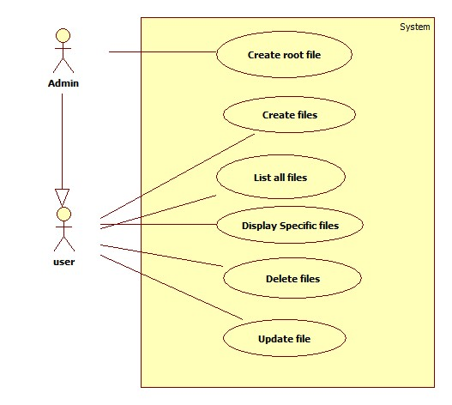
USE CASE

Slide 6
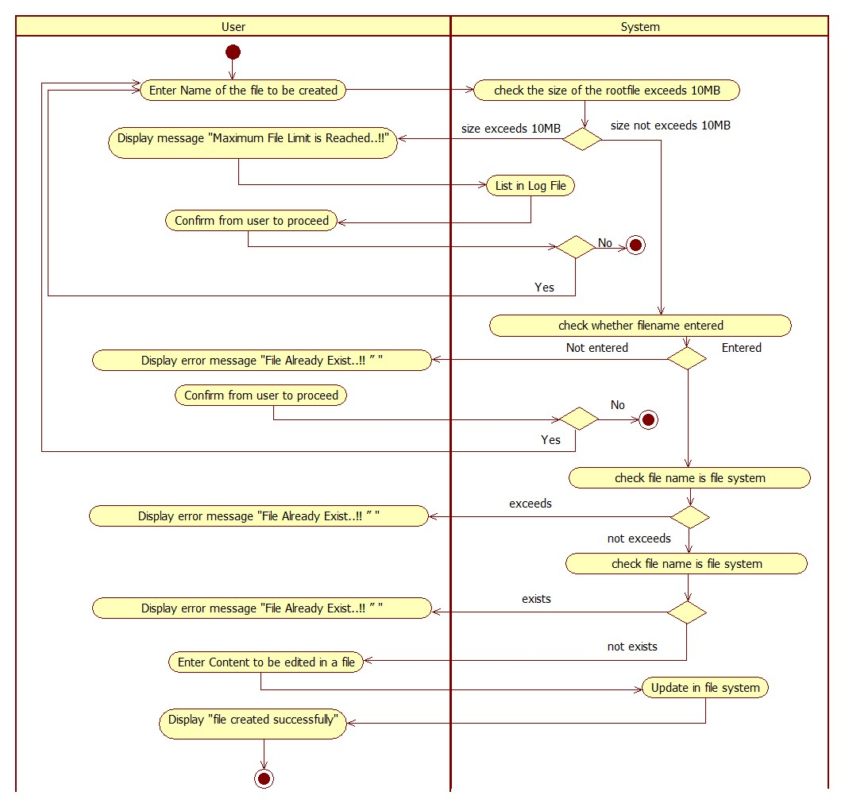
CREATE FILE IN FILE SYSTEM

Slide 7
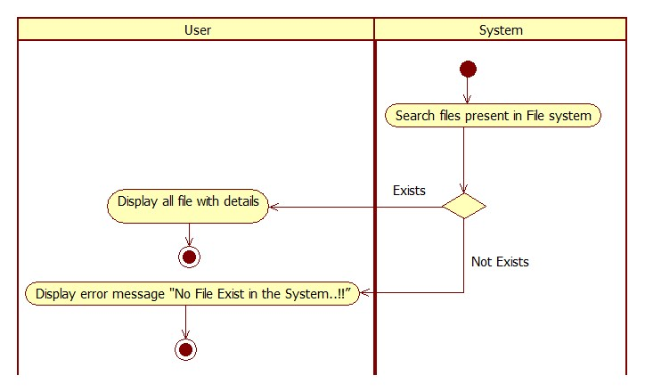
LIST ALL FILES FROM FILE SYSTEM

Slide 8
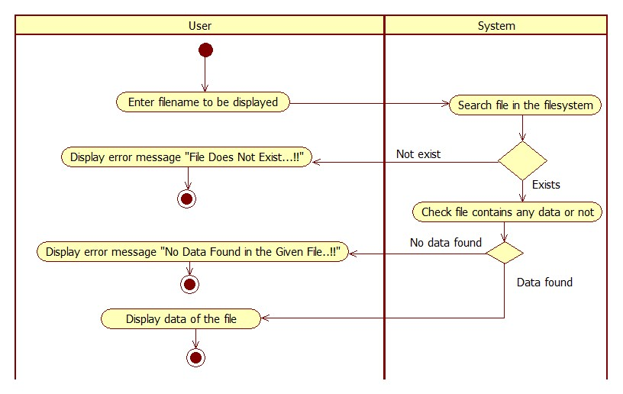
DISPLAY A SPECIFIC FILE

Slide 9
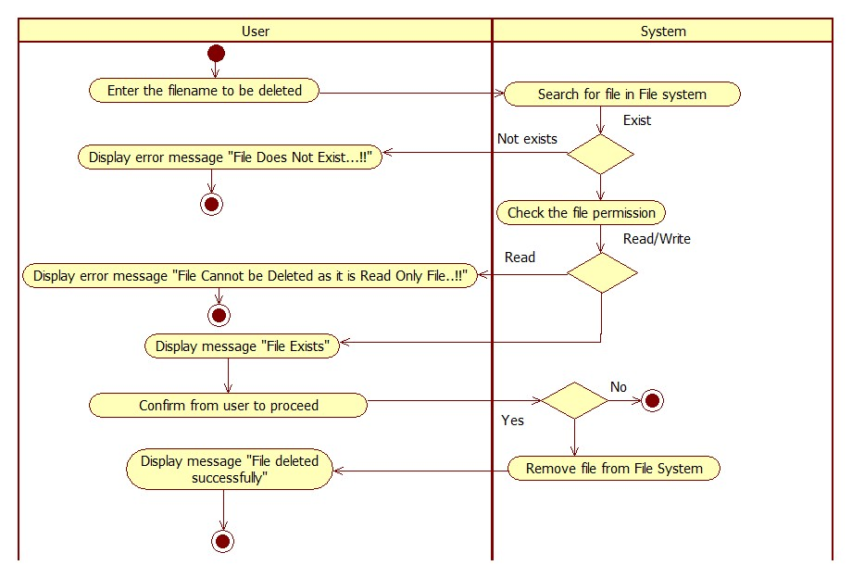
DELETE FILE FROM FILE SYSTEM

Slide 10
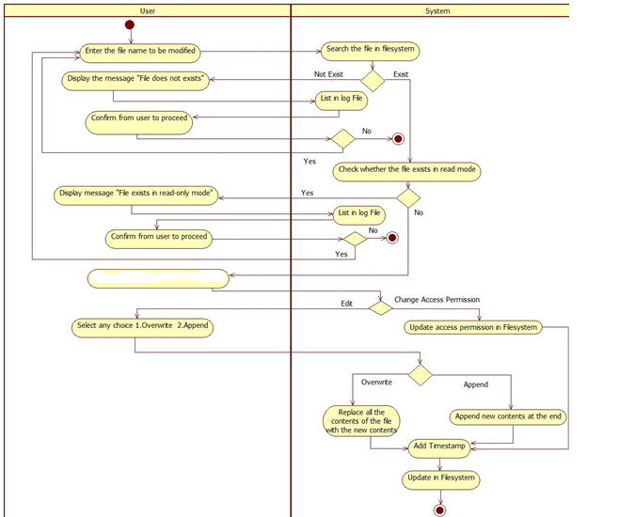
MODIFY FILE IN FILE SYSTEM
Edit

Slide 11
No. of Defects encountered : 5
No. of Defects resolved : 4
No. of bugs encountered : 5
No. of bugs resolved : 4

Slide 12
FUTURE SCOPE
To implement user access permissions on files.
To implement variable size data blocks.
To store content of the same file into discontiguous data blocks.
Efficient use of data blocks that got free due to deletion of file content.

Slide 13
REFERENCES
Let Us C – Yashwant Kanetkar
UML with rational rose – Wendy Boggs

Slide 14
THANK YOU

